Slide 1
14. Binary Trees
ECE 309
Dr. James Tuck

Slide 2
Objectives
Define binary tree, its structure, and common terms used to describe them.
Build simple binary trees in code.
Define binary search tree (BST) and the properties that must hold for data stored in them.
Explain why BST search and insert are considered faster than the equivalent operation on a linked list.
Explain the BST insert and search algorithm; work them out by hand; implement them in code.
Implement C++ code for BST insert and search.

Slide 3
Data Structures
Linked lists
Hold elements in an order
No structural limitation on how large it can become.
Slow to search.
Hash tables
Quick to search given a good hash function and large enough table.
Elements are not ordered.
Binary tree
Holds elements in an order.
No structural limitation on how large it can become.
Faster to search than a linked list: O(log n)

Slide 4
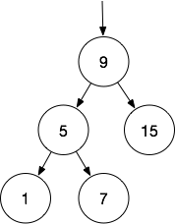

Binary Tree
In a linked list, each node has one successor.
In a binary tree, each node has up to two children.
Binary Tree

Slide 5
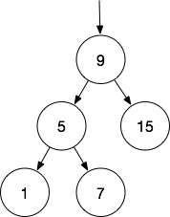
Common Terms
Leaf nodes have no children.
1, 7, and 15 are leaf nodes.

Slide 6
Common Terms
A node with a child is called the child’s parent; a node can have a left child and a right child.
9 is the parent of 5 and 15.
5 is the parent of 7 and 1.
5 is the left child of 9.
15 is the right child of 9.

Slide 7
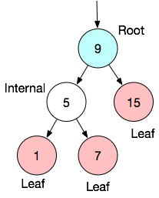
Common Terms
Internal nodes have at least one child.
The tree always starts at the root node.
The root is often drawn at the top,
but, in general, it must be specified
explicitly.

Slide 8
Class for a binary tree node
class BTNode { // Binary Tree (BT) Node
public:
int data; // data in the tree
BTNode *left; // left child
BTNode *right; // right child
BTNode(int d, BTNode *l=NULL, BTNode *r=NULL)
{ data = d; left = l; right = r; }
};

Slide 9
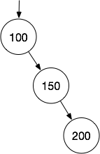
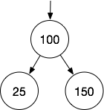
Example
Write code that builds binary trees equivalent to the ones shown below.

Slide 10
Common Terms
A node’s ancestors include its parent, its parent’s parent, etc, all the way up to the root and including it.
9 is the ancestor of 1, 5, 7, and 15.
7’s ancestors are 5 and 9.

Slide 11
Common Terms
A sub-tree is the set of nodes starting at a node and extending to its children, its children’s children, and so on.
The sub-tree starting at 5 includes 5, 1, and 7.
The sub-tree starting at 15 includes only 15.
The sub-tree starting at 9 includes 1, 5, 7, 9, and 15,
which is actually the whole tree.

Slide 12
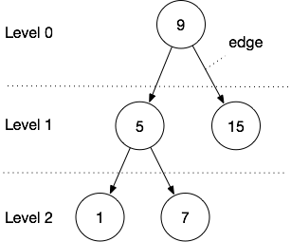
Common Terms
A connection between nodes is called an edge.
A node’s depth is the number of edges on the path from the root to the node.
Node 5 has a depth of 1.
Node 7 has a depth of 2.
All the nodes at the same depth form a level.
A tree’s height is the largest depth of any node.

Slide 13
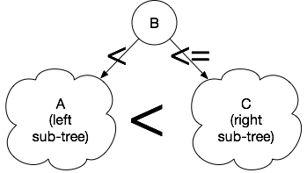
Binary Search Tree (BST)
We can place additional rules on where data can be placed in a tree to make search efficient.
A binary search tree obeys the following rules:
A parent is greater than all nodes in its left sub-tree
For all a in A , a < B
A parent is always less-than or equal to all nodes in its right sub-tree
For all c in C, B <= c
=
=

Slide 14
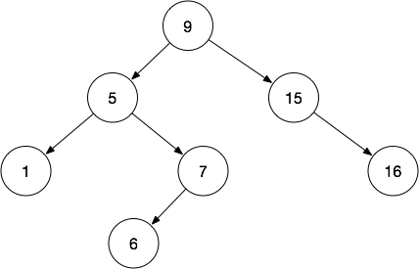
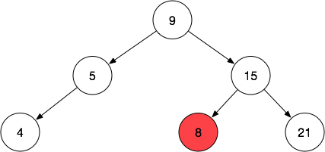
Examples of BSTs
Legal BST.
Illegal BST, 8 is smaller than 9, but is in 9’s right sub-tree.

Slide 15
Examples of BSTs
Legal BST.
Illegal BST, 8 is smaller than 9, but is in 9’s right sub-tree.

Slide 16
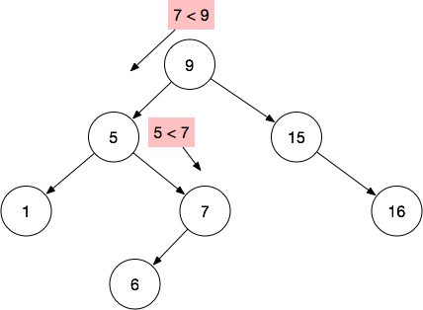
Searching a BST
Given a BST, we can search for an item in the binary tree by exploiting the ordering.
Example:
Search for 7 starting at root:
Compare 7 to root (9)
7 is lesser, search to the left
Compare 7 to 5
7 is greater, search to the right
Found 7!

Slide 17
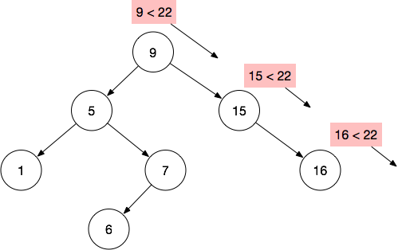
Searching a BST
Example:
Search for 22 starting at root:
Compare 22 to root (9)
22 is greater, search to the right
Compare 22 to 15
22 is greater, search to the right
Compare 22 to 16
22 is greater search to the right
No right child, 22 not found!

Slide 18
BST Search pseudocode (not C++)
bool BSTSearch(tree, data) {
node = tree->root
while (node not null) {
if (node->data == data) return true
else if (data < node->data) node = node->left;
else node = node->right;
}
return false;
}

Slide 19
How efficient is the BST search?
Assume N nodes in the BST and a height of H.
Each comparison moves us down one level of the tree, to the deepest level in the worst case
Search is O(H).
We can approximate H as log₂N
H is approximately log₂ N if the binary tree is perfectly filled.
Hence, BST search can be as efficient as O(log N)

Slide 20
Inserting nodes into the BST
New nodes must obey the BST ordering rules:
If it’s the first node to insert, it becomes the root.
Otherwise, we insert lesser values to the left sub-tree or greater-than-or-equal values to the right sub-tree.
We insert at the first node we reach that has a missing child and that satisfies the ordering rules.

Slide 21
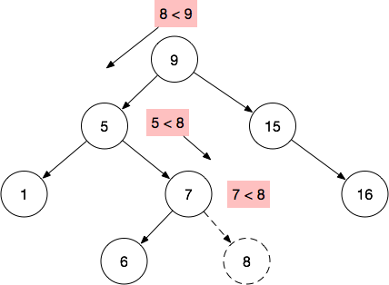
BST insertion example
Example:
Insert 8:
Compare 8 to root (9)
8 is lesser, insert to the left
Compare 5 to 8
8 is greater, search to the right
Compare 7 to 8
8 is greater search to the right
No right child, insert 8 there!

Slide 22
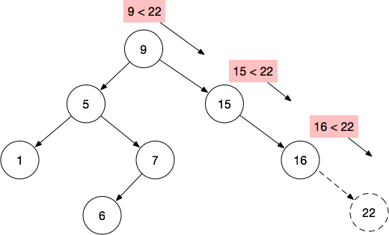
BST insertion example
Example:
Insert 22:
Compare 22 to root (9)
22 is greater, insert to the right
Compare 22 to 15
22 is greater, insert to the right
Compare 22 to 16
22 is greater insert to the right
No right child, insert 22!

Slide 23
BST insertion pseudocode
BSTInsert(tree, node) {
if (tree->root == null) {
tree->root = node;
node->left = null;
node->right = null;
else {
tmp = tree->root
while (tmp != null) {
if (node->data < tmp->data)
if node->left is null, insert here and break;
else tmp = node->left;
else
if node->right is null, insert here and break;
else tmp = node->right;
}
}
Initial case, insert the root

Slide 24
BST insertion pseudocode (not C++)
BSTInsert(tree, node) {
if (tree->root == null) {
tree->root = node;
node->left = null;
node->right = null;
else {
tmp = tree->root
while (tmp != null) {
if (node->data < tmp->data)
if tmp->left is null, insert here and break;
else tmp = tmp->left;
else
if tmp->right is null, insert here and break;
else tmp = tmp->right;
}
}
The while loop traverses down the tree, one level per iteration until we find a leaf where we can insert.
Note, tmp = tmp->left looks a lot like a linked list traversal!

Slide 25
BST insertion pseudocode
BSTInsert(tree, node) {
if (tree->root == null) {
tree->root = node;
node->left = null;
node->right = null;
else {
tmp = tree->root
while (tmp != null) {
if (node->data < tmp->data)
if tmp->left is null, insert here and break;
else tmp = tmp->left;
else
if tmp->right is null, insert here and break;
else tmp = tmp->right;
}
}
When we find a null child, we can place the new node there.
It may be on the left or right depending on the values in the tree.

Slide 26
BST Class for integers
class BinarySearchTree {
protected:
class BTNode {...}; // from previous slide
BTNode *root;
Public:
BinarySearchTree() { root = nullptr; }
virtual void insert(int);
virtual bool search(int);
}

Slide 27
BinarySearchTree::insert
void BinarySearchTree::insert(int data) {
BTNode *node = new BTNode(data); // create new node, left and right set to NULL!
if (root==NULL)
root = node; // this node becomes the root! We’re done.
else { // else, find the right place to insert
BTNode *tmp = root;
while (tmp != NULL) {
if(data < tmp->data) {
if (tmp->left == NULL) { tmp->left = node; break; } //insert as left child
else tmp = tmp->left;
} else
if(tmp->right == NULL) { tmp->right = node; break; } //insert as right child
else tmp = tmp->right;
}
}
}

Slide 28
BinarySearchTree::search
void BinarySearchTree::search(int data) {
BTNode *tmp = root;
while (tmp != NULL) {
if(data == tmp->data)
return true; // found it!
if(data < tmp->data)
tmp = tmp->left;
else
tmp = tmp->right;
}
return false; // made it to end of tree with no match
}

Slide 29
Summary
Binary search trees are a good for high speed of search while holding nodes in an order
Nodes in a binary tree have two children: left and right
In a binary search tree, the left sub-tree is <= the parent, and right sub-tree is >= parent.
BST search and insert exploit the ordering property to provide O(log N) insertion and search.

Slide 30
References
1. ZyBook on Data Structures, chapters 16.1, 16.2, 16.3, 16.4
2. BST visualizer

